Slide 1


Developed by Alagu Meiappan & Subha Nair

Slide 2

AGENDA
Introducing MAP-Ed AR
What is the problem we are trying to solve?
Who is it for?
The Interface and Interactions
Prototype
Usability Test Plan
Next Steps

Slide 3

A fun, interactive and educational augmented reality app that makes geographical facts come to life.
A kid-friendly map to visualize flags, monuments and animals of various countries.
Easier for kids to retain the information they learn.
What is
MAP-Ed AR ?

Slide 4

Educators do not have the time to cater to each child’s needs.
Attention and involvement is needed to promote engagement in learning
Make learning process more intuitive and enjoyable for a child through AR.
What is the Problem we are trying to solve ?

Slide 5
Getting to know our users
Our design process started with the user, a user-centric research to gain more insight about our target group.
A participatory design approach by incorporating students, teachers into the active co-ideation process.
Market analysis to know what’s already out their in the market.

Slide 6
Who is it for ?
Target group for this app would be children in Grades 5-6+ (age 10 and older).
Elementary-age and preadolescent children who are able to use maps with different symbol systems.
Teachers who are willing to try better and innovative teaching tools for lessons and make learning more fun.

Slide 7
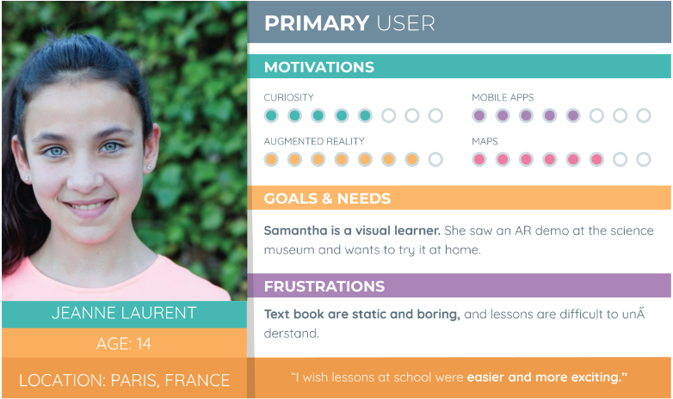

Slide 8
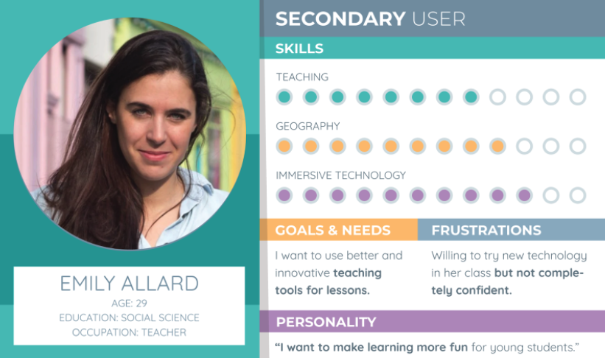

Slide 9
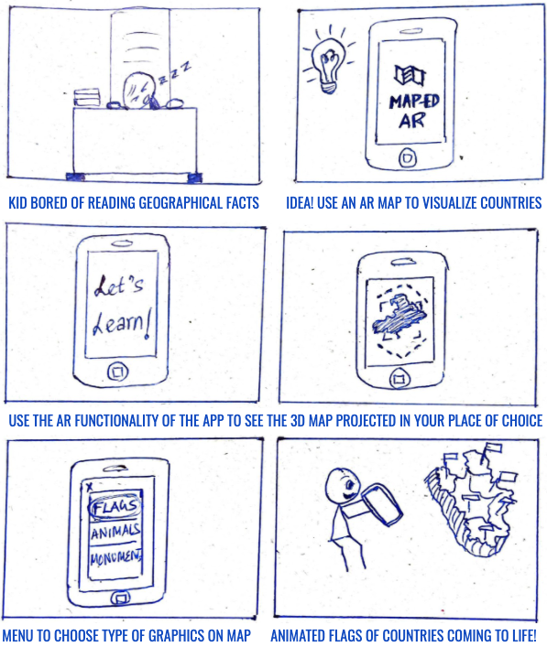
Storyboarding the Interactions

Slide 10
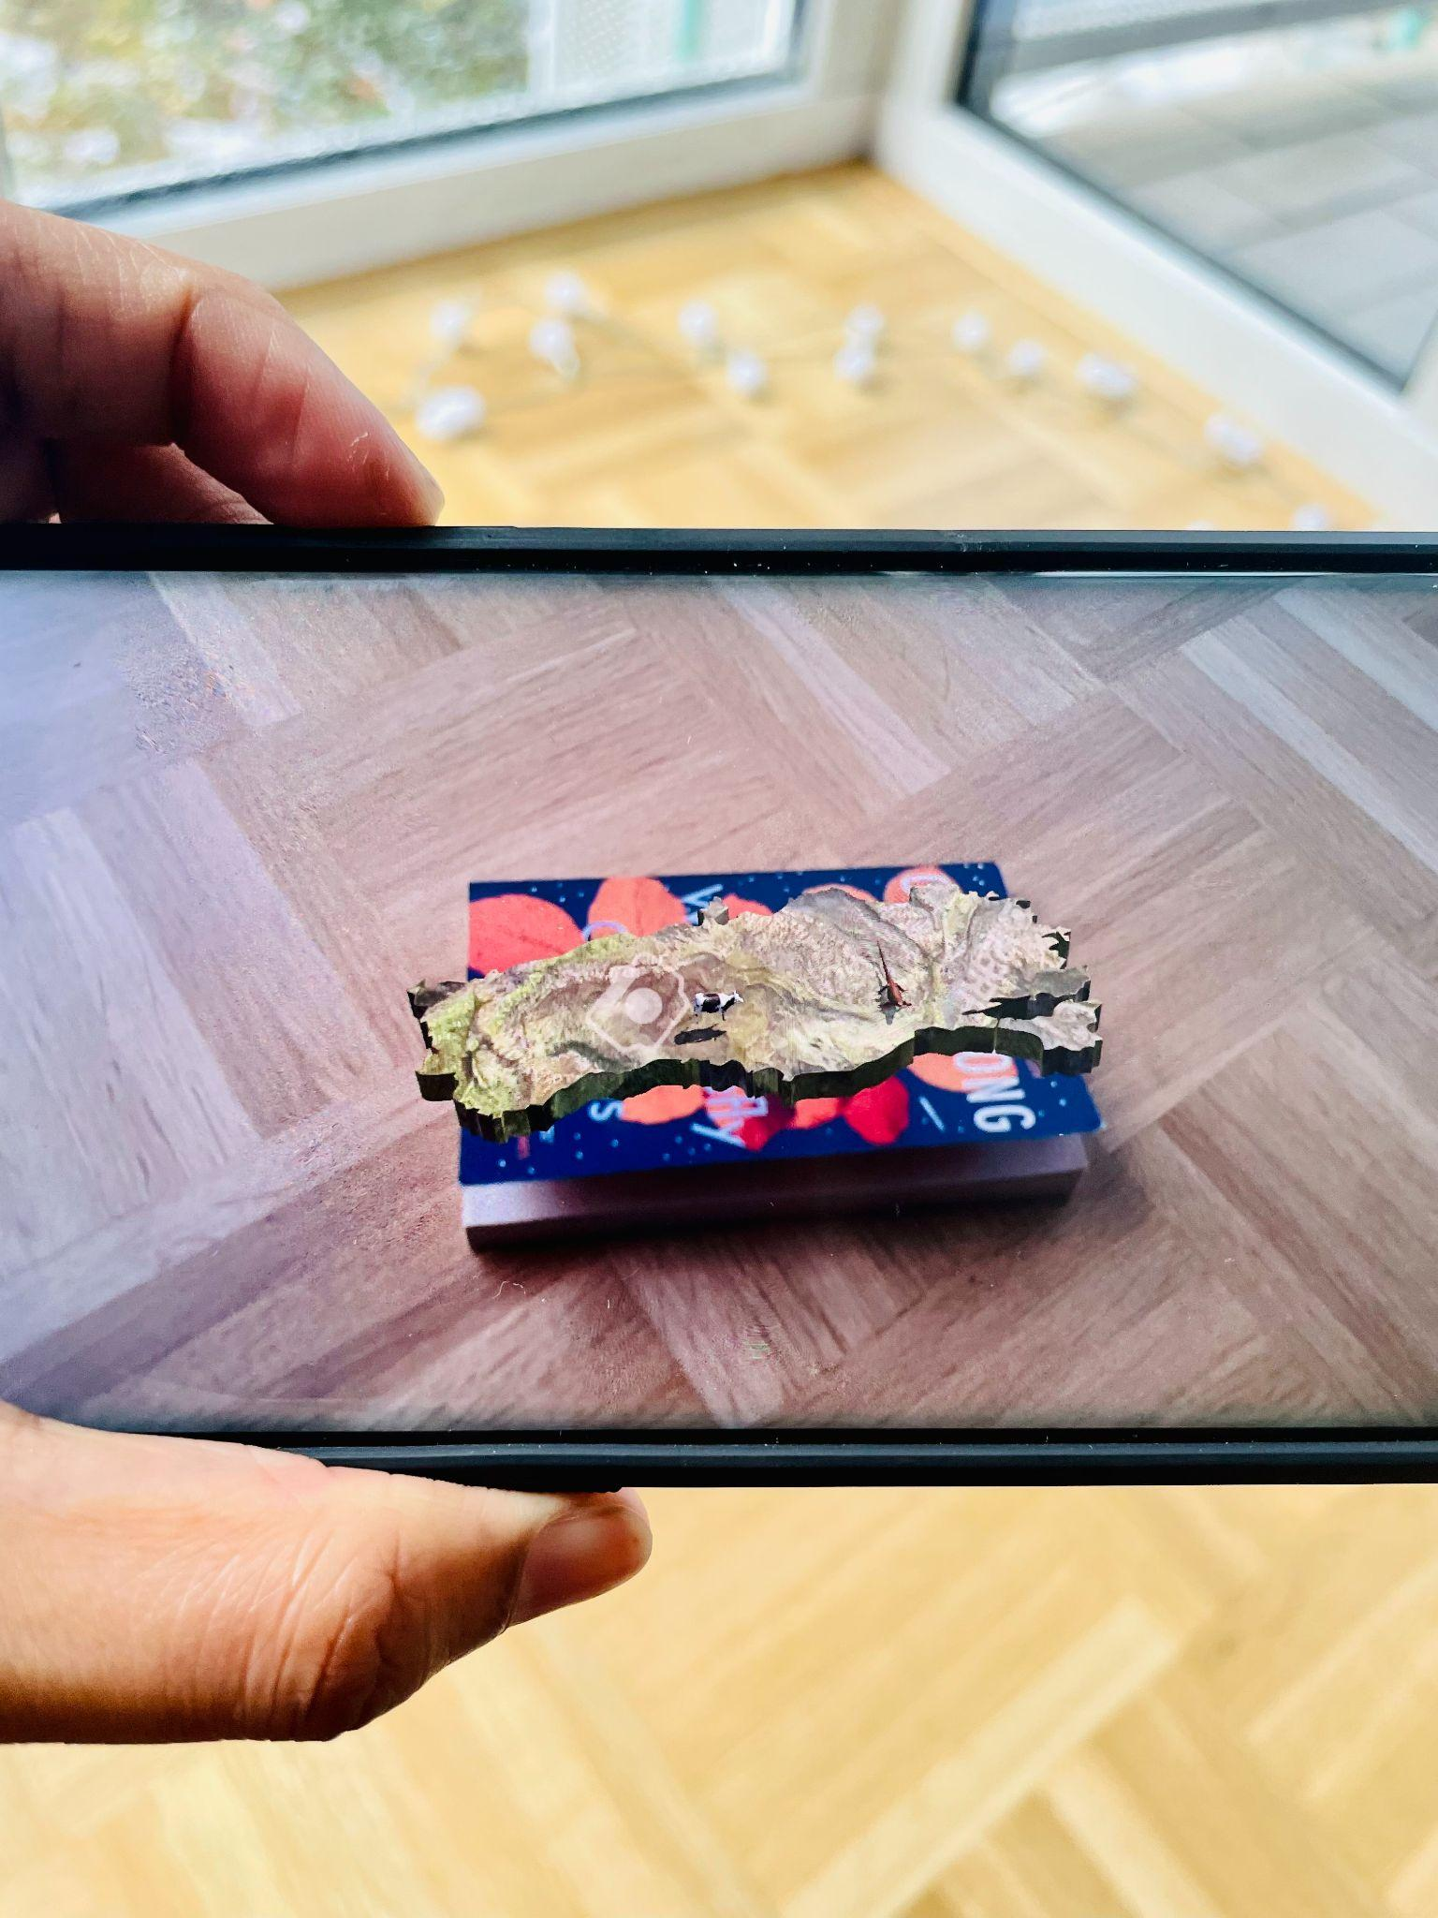
Prototype (MVP)
Marker-based AR
An example map with a few 3D models projected

Slide 11
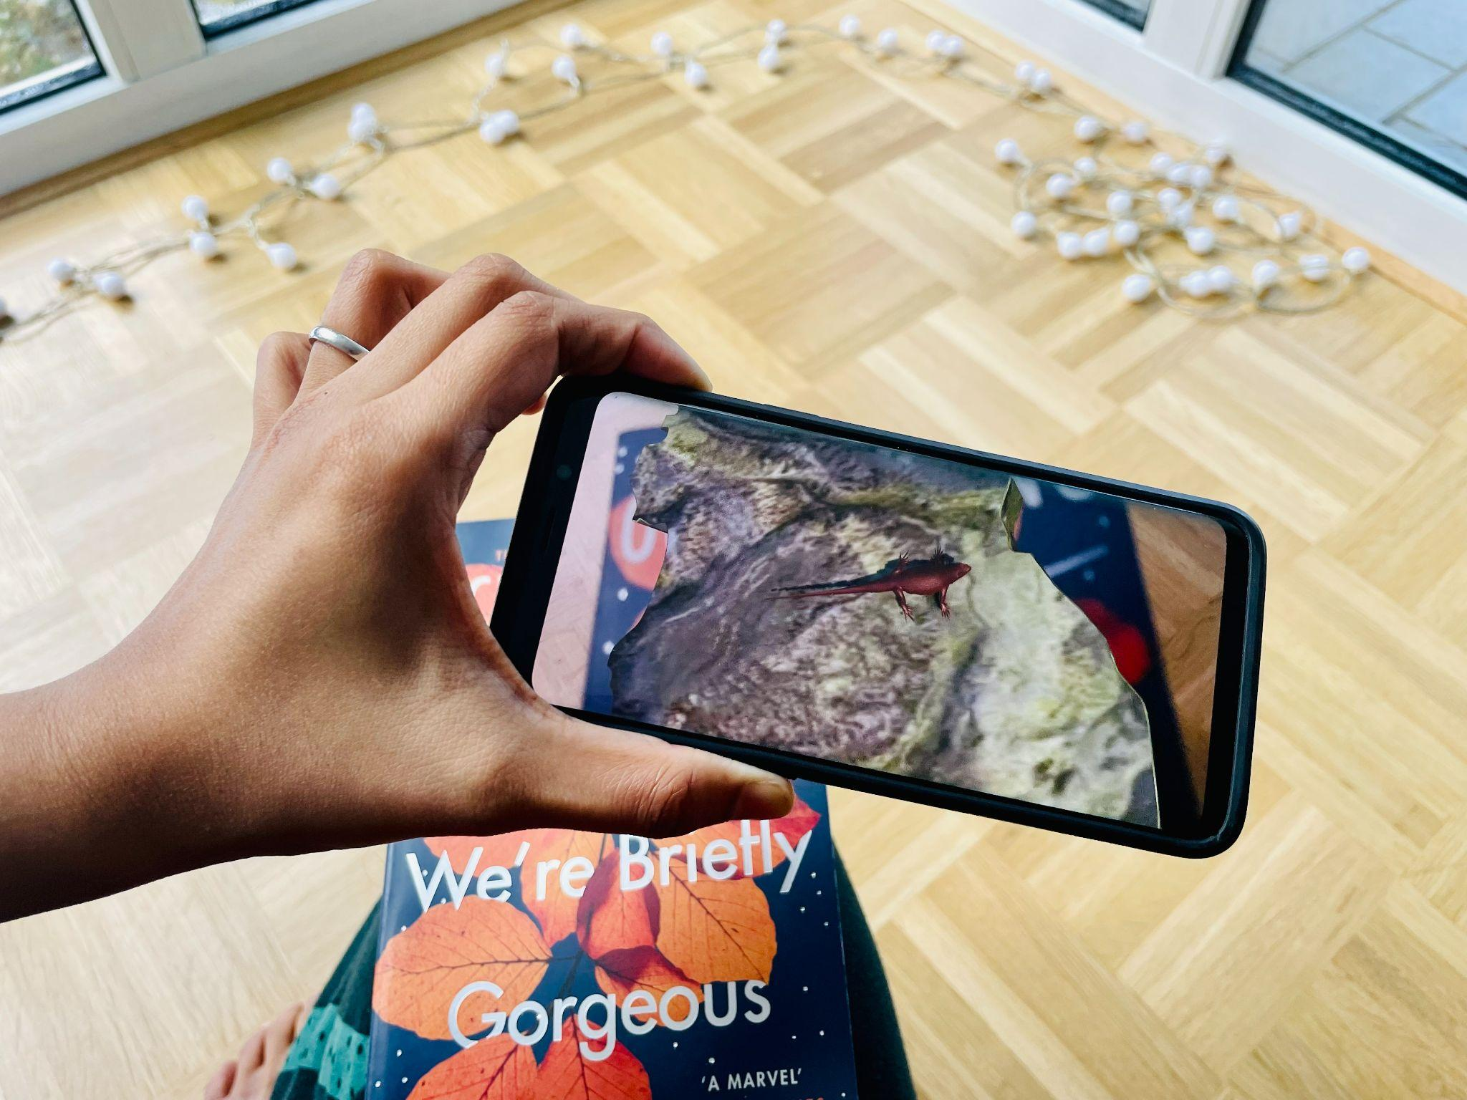
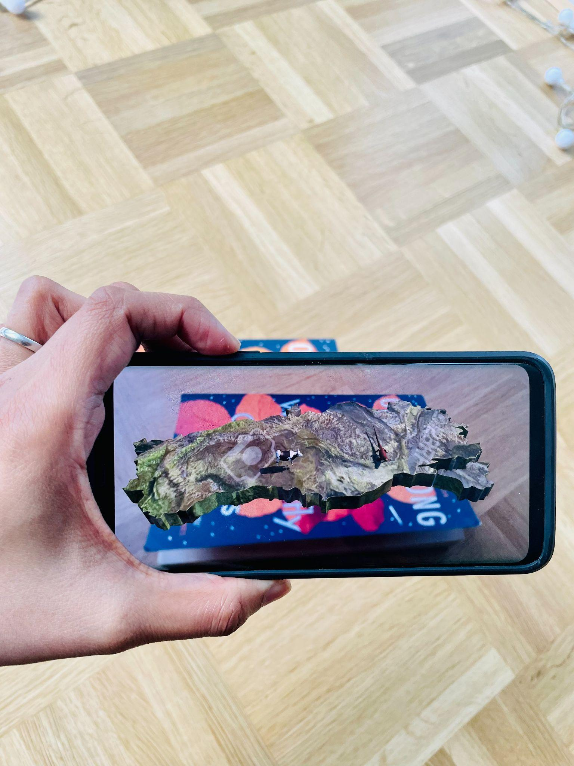

Slide 12
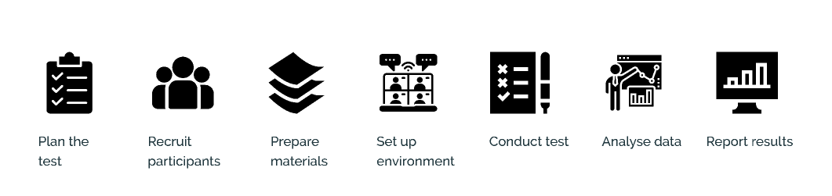
Usability Test Plan
In contact with students and teachers from Gymnasium Gaimersheim.
Conducting usability test and analysing the data before the deadline.

Slide 13
Quantitative Analysis
System Usability Scale (SUS)
User Experience Questionnaire (UEQ)
Qualitative Analysis
Interview Guide
Custom questionnaire
Usability Test Approach

Slide 14


Considering our target group, how can we modify the current method of interaction ?
ⓘ Start presenting to display the poll results on this slide.
Notes:
📣 This is Slido interaction slide, please don't delete it. ✅ Click on 'Present with Slido' and the poll will launch automatically when you get to this slide.

Slide 15
Any suggestions how our app could be improved ?
ⓘ Start presenting to display the poll results on this slide.
Notes:
📣 This is Slido interaction slide, please don't delete it. ✅ Click on 'Present with Slido' and the poll will launch automatically when you get to this slide.

Slide 16
Running a usability test with our target group.
Analysing and summarizing our test results.
Using the evaluation results to improve our app prototype.
Next Steps

Slide 17
Thank you for your attention

